Slide 1

INTEGRATION OF ASL DETECTION SYSTEM IN A DRIVE - THROUGH
SUBMITTED BY:
ABHINEET SHARMA (1802913007) LEADER
ANUPAM CHOPRA (1802913038) CO - LEADER
PA - 7
DEPARTMENT OF INFORMATION TECHNOLOGY,
KIET GROUP OF INSTITUTIONS, GHAZIABAD, UTTAR PRADESH
(AFFILIATED TO DR. A.P.J ABDUL KALAM TECHNICAL UNIVERSITY, LUCKNOW,UTTAR PRADESH, INDIA)

Slide 2
TABLE OF CONTENTS
1
IDEOLOGY
2
PROPOSAL
3
STIMULATION
4
5
REVIEW
REFERENCES

Slide 3
IDEOLOGY
The basic ideology behind this project was to make any customer based utility service more friendly for the people who are disabled (deaf and mute specifically)
Since they are taught sign – language as an alternative for the standard way of interacting with others to overcome the barriers of communication, a lot of them face problems in day – to – day life like: ordering food at a “Drive – thru ” or having a conversation with an attendant who is oblivious to their predicament and whose incompetence might be a bit irritating for the person who is disabled.
So, the ASL Detection is based on Image Processing and Object Detection integrated with a Computer webcam or any other video detecting accoutrements in order to help both; the customer and the retailer to have a better engagement whilst having a conversation.

Slide 4
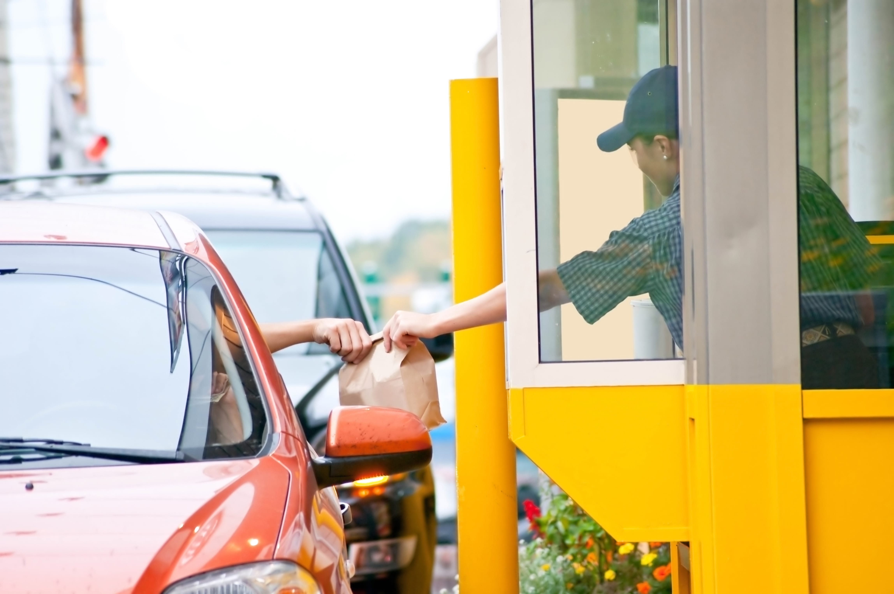
WHAT’S A DRIVE THROUGH
A drive-through or drive-thru, is a type of take-out service provided by a business that allows customers to purchase products without leaving their cars
A CONVENTIONAL DRIVE – THROUGH SERVICE FOR FAST – FOOD

Slide 5
WHY DO WE NEED ONE ?
Drive thru sales represent 70% of fast food sales which generates billions of dollars for the industry each month. (The New York Times)
According to the NPD Group, a leading market research company, 57% of hamburger fast food customers use the drive-thru lane, 40% with Mexican QSRs, and 38% of chicken fast food customers went straight to drive through lanes.
(Statistics By : Patrick Limdico Based on the American Fast Food Market )

Slide 6
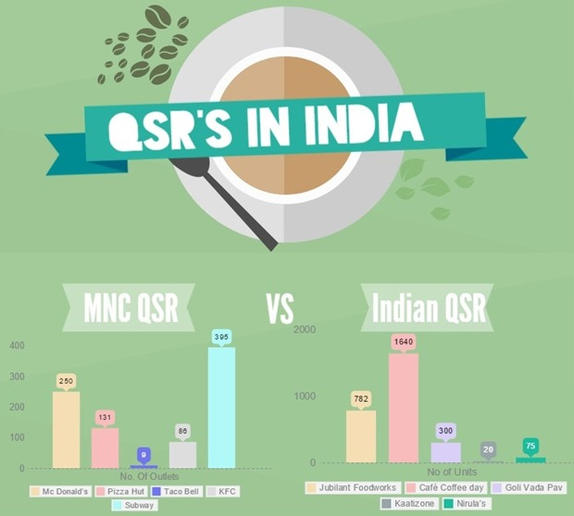
The fast food industry in India has evolved with the changing lifestyles of the young Indian population.
The variety of gastronomic preferences across the regions, hereditary or acquired, has brought about different modules across the country.
Statistics By : Vaishnavi Kanekal (2015)

Slide 7
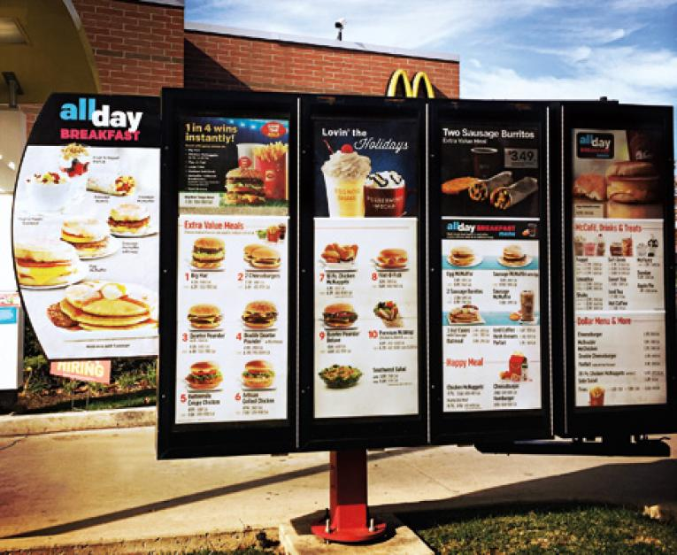
WHAT A TYPICAL MENU AT A DRIVE THROUGH LOOKS LIKE
Digital signage is a sub-segment of electronic signage. Digital displays use technologies such as LCD, LED, projection and e-paper to display digital images, video, web pages, weather data, restaurant menus, or text

Slide 8
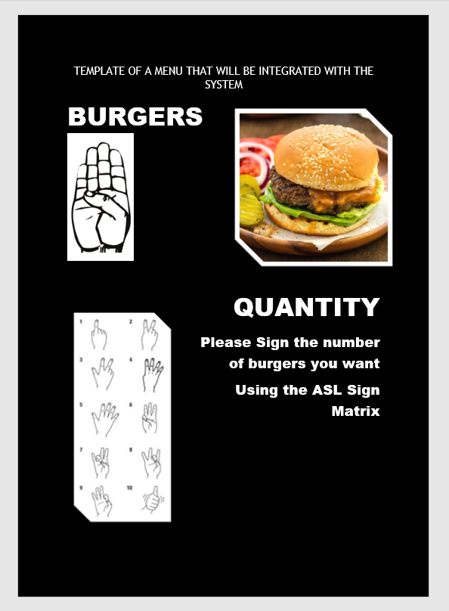
This menu will have all the items listed in it along with the corresponding letter with which the name of the item starts.
If a person selects a burger, he/she will have to make the symbol illustrated in the menu to order it.
For mentioning the quantity, they will have to use the ASL Digit Matrix to Submit the number of food items that they have ordered.

Slide 9
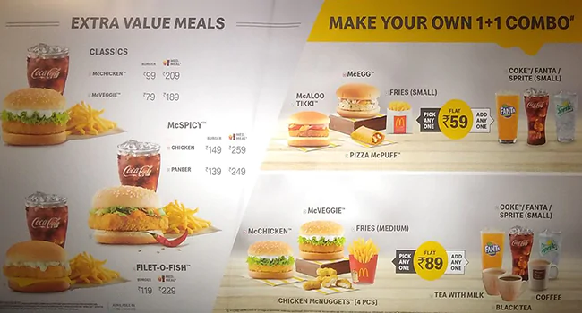
ORDERING AT A QSR
ITEM LIST | QUANTITY | PRICE
McAloo TIKKI | 2 | 64
McCHICKEN | 2 | 178
McVEGGIE | 1 | 70
FRIES | 2 | 120
FANTA | 2 | 80
TEA WITH MILK | 1 | 55
COKE | 2 | 80
 | TOTAL | ₹ 647

Slide 10
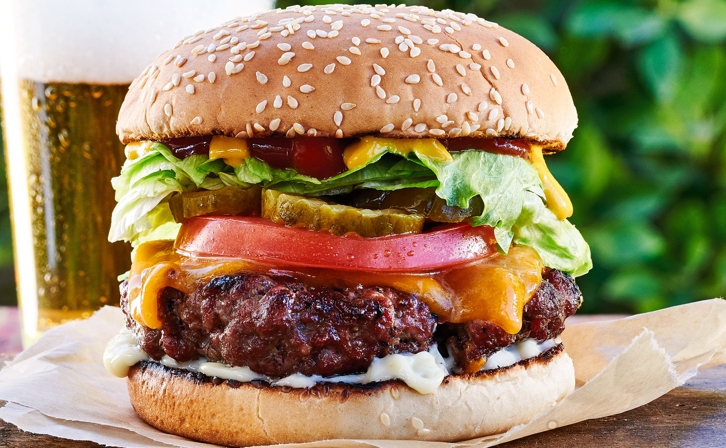
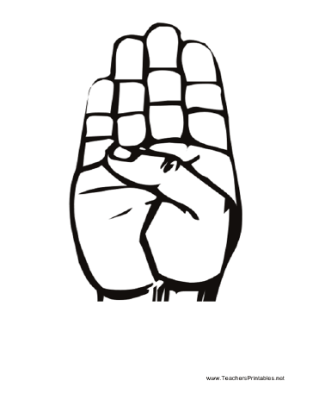
BURGERS

Slide 11
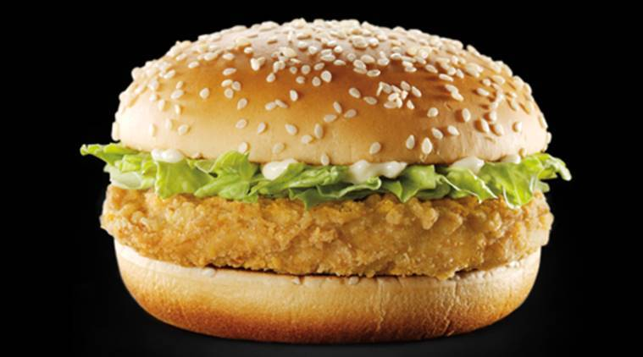
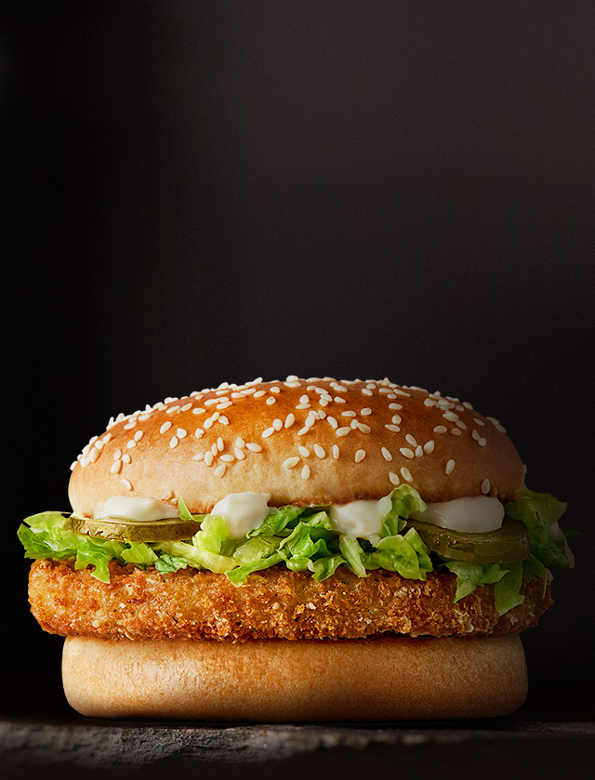
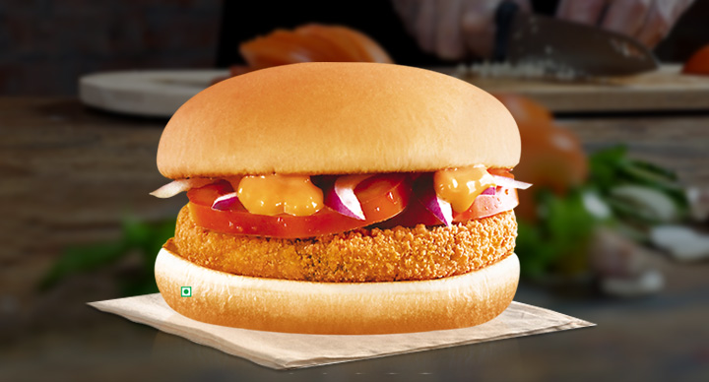
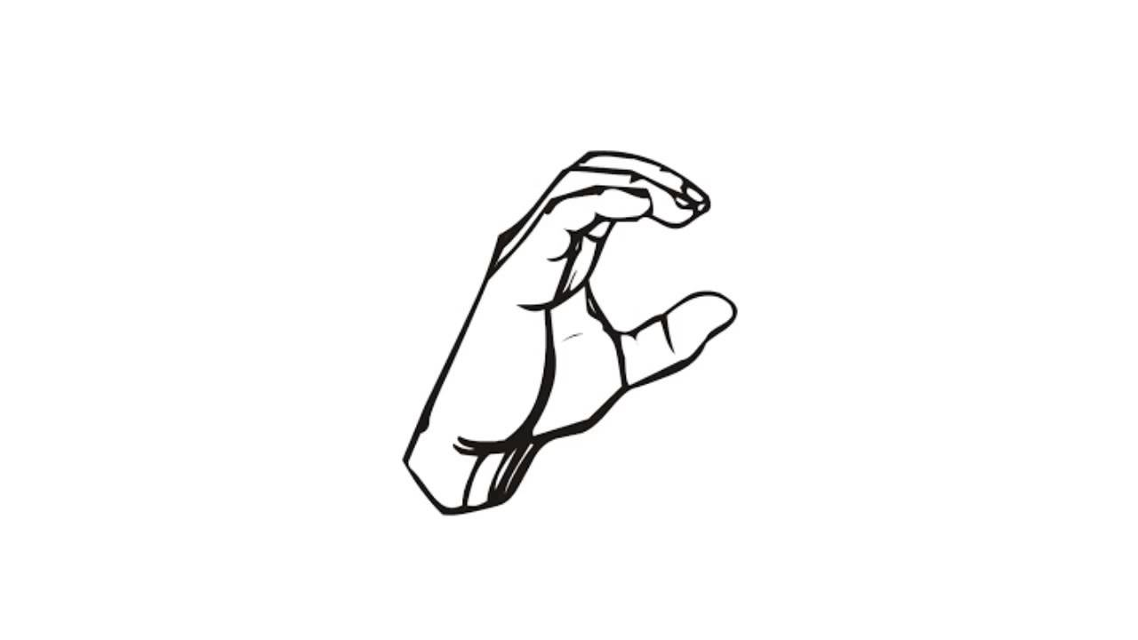
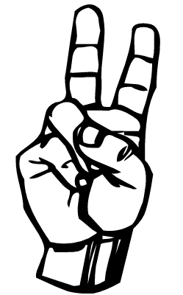
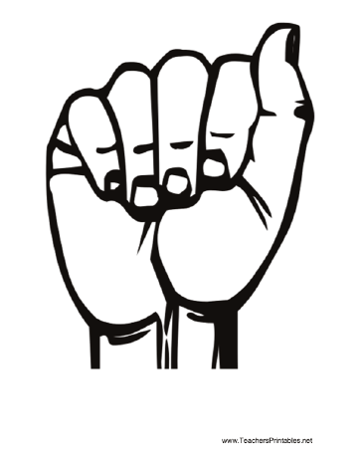
McCHICKEN
McVEGGIE
McALOO TIKKI

Slide 12
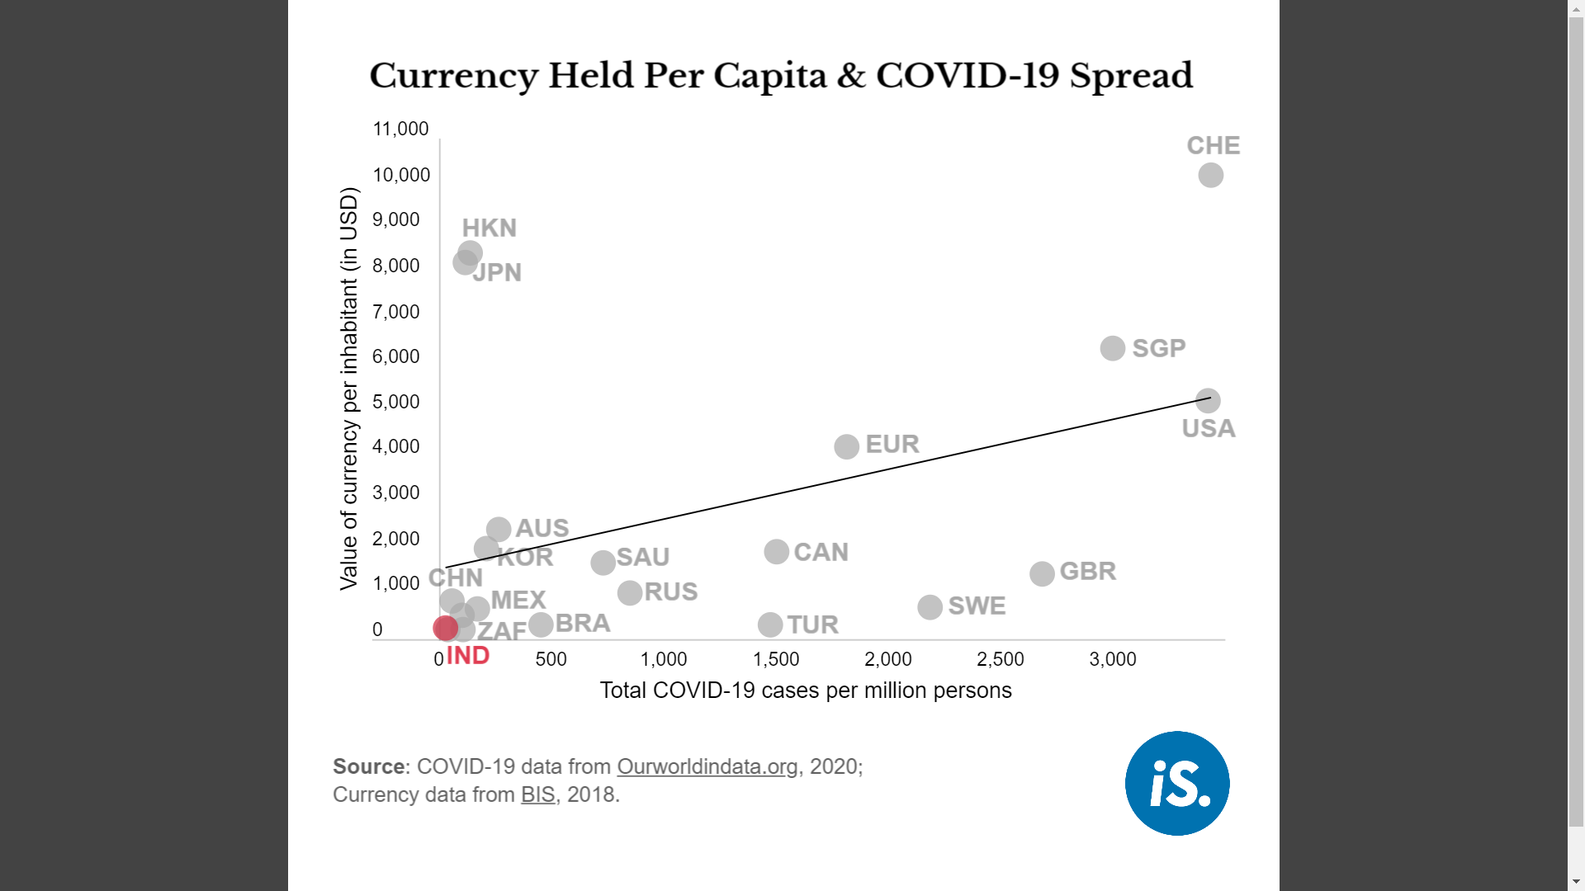
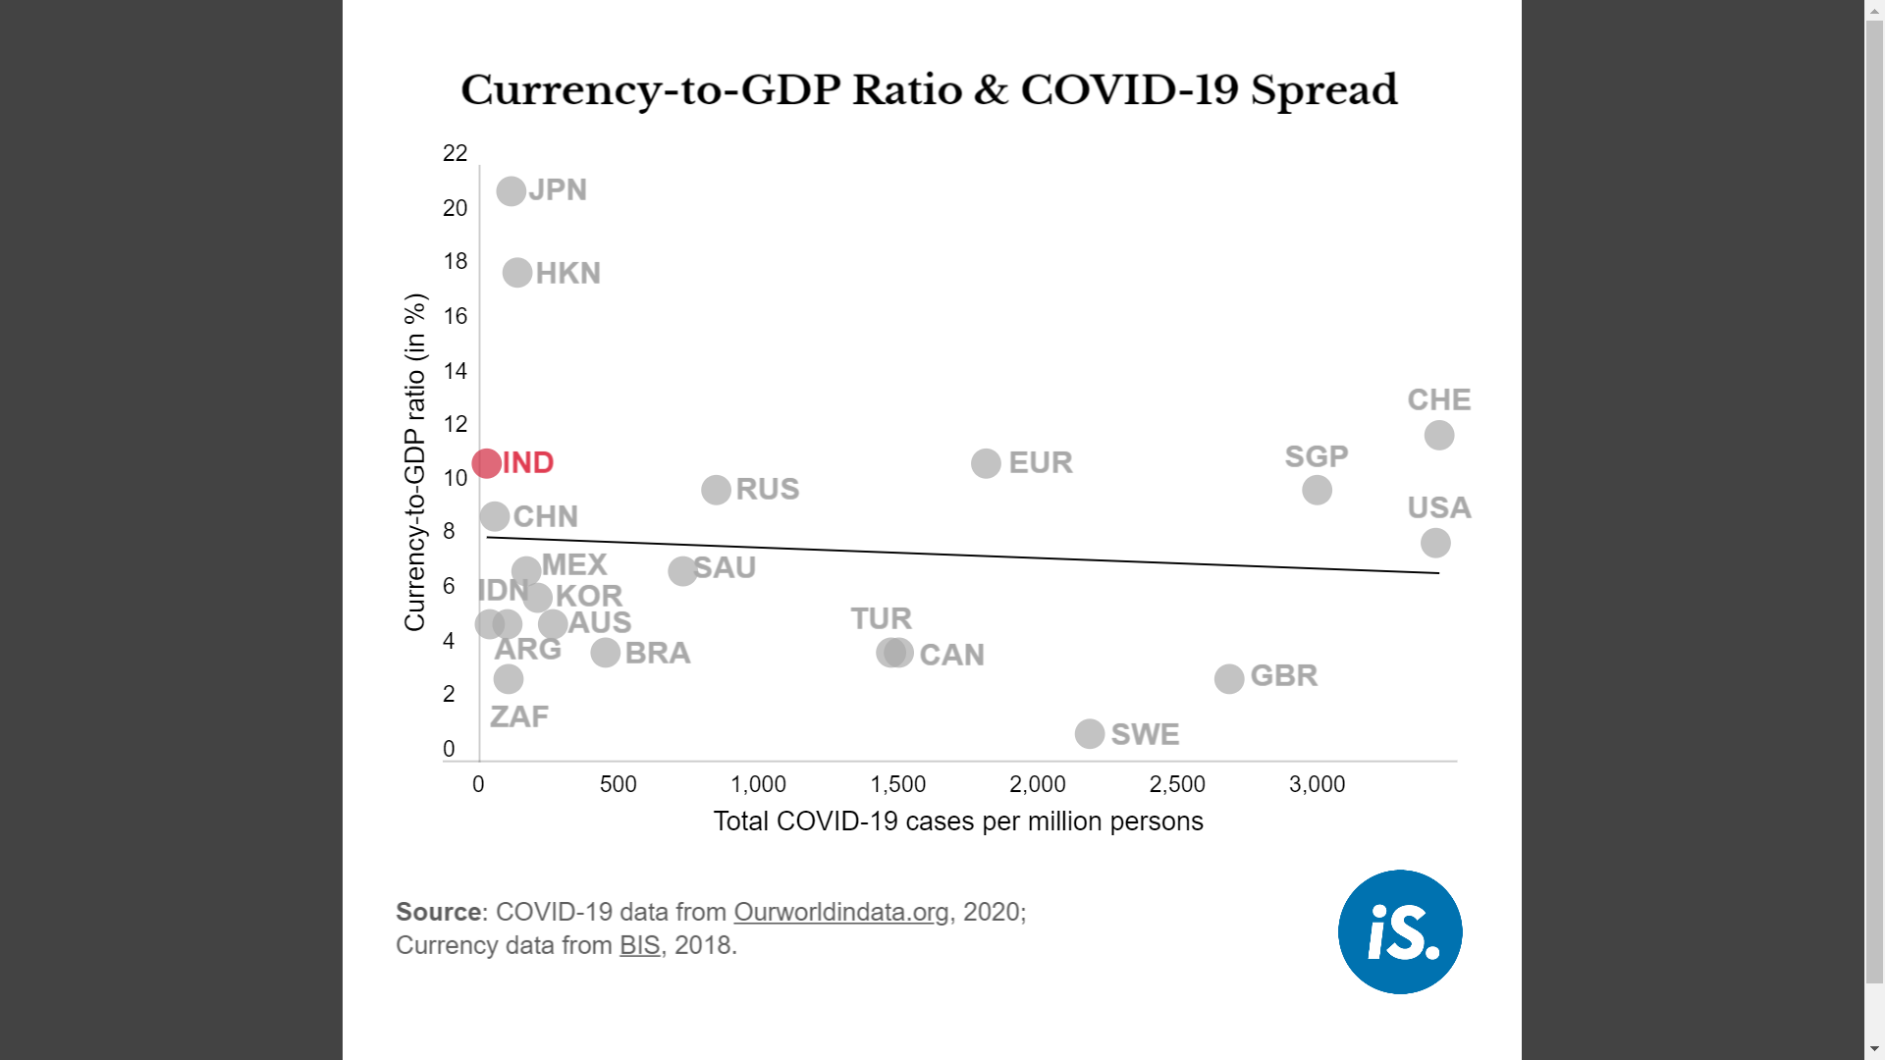
NO CLEAR LINK TO CURRENCY NOTES AND COVID-19 SPREAD

Slide 13
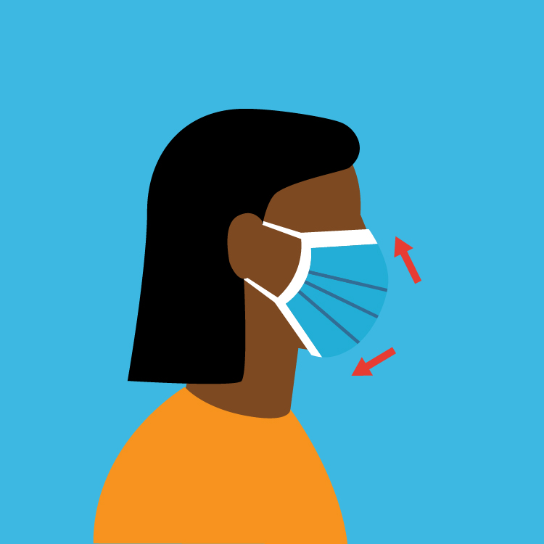
WHY WE CAN’T USE A MICROPHONE
Since the outset of the COVID-19 pandemic debate has been growing about the benefits or otherwise of the general public wearing face masks to help control the spread of the virus. While arguments exist on both sides of the debate, history and culture has played a crucial role in polarising opinions. Nevertheless, all countries have accepted the need for mitigation strategies and importantly, the views of public health advisors and most governments have now converged in favour of wearing masks.

Slide 14
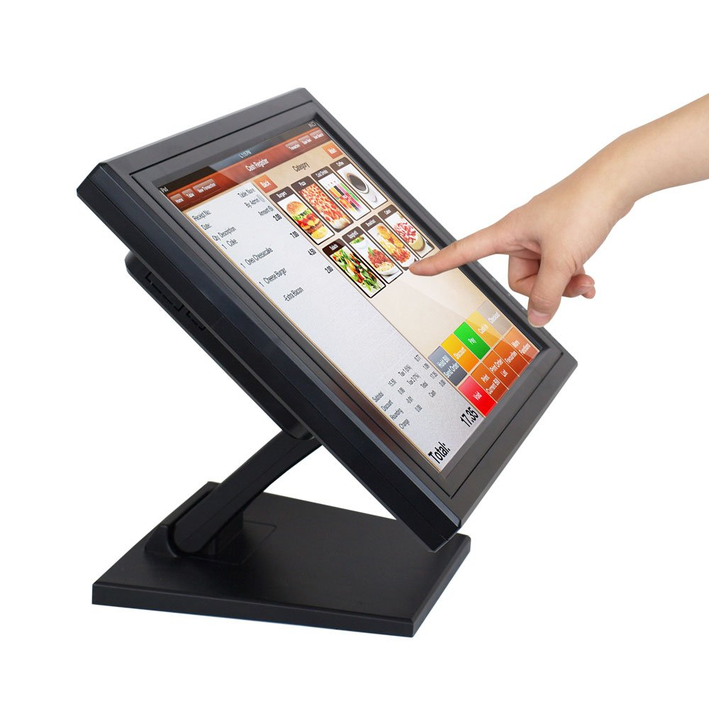
CAN’T TOUCH THIS
People with the virus in their noses and throats may leave infected droplets on objects and surfaces (called fomites) when they sneeze, cough on, or touch surfaces, such as tables, doorknobs and handrails. Other people may become infected by touching these objects or surfaces, then touching their eyes, noses or mouths before cleaning their hands.

Slide 15
ASL GESTURE ANALYSIS USING TensorFlow BACKEND AND OpenCV
How it Works ?

Slide 16
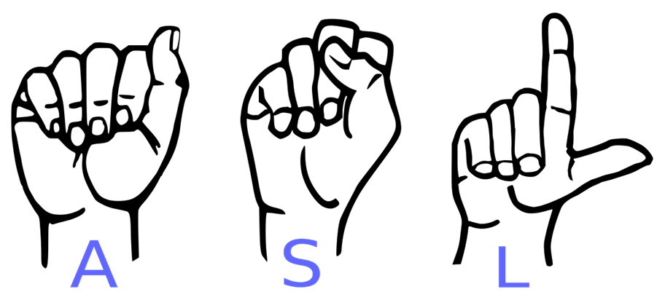
INTRODUCTION
American Sign Language (ASL) is a complete, natural language that has the same linguistic properties as spoken languages, with grammar that differs from English. ASL is expressed by movements of the hands and face. It is the primary language of many North Americans who are deaf and hard of hearing, and is used by many hearing people as well.

Slide 17
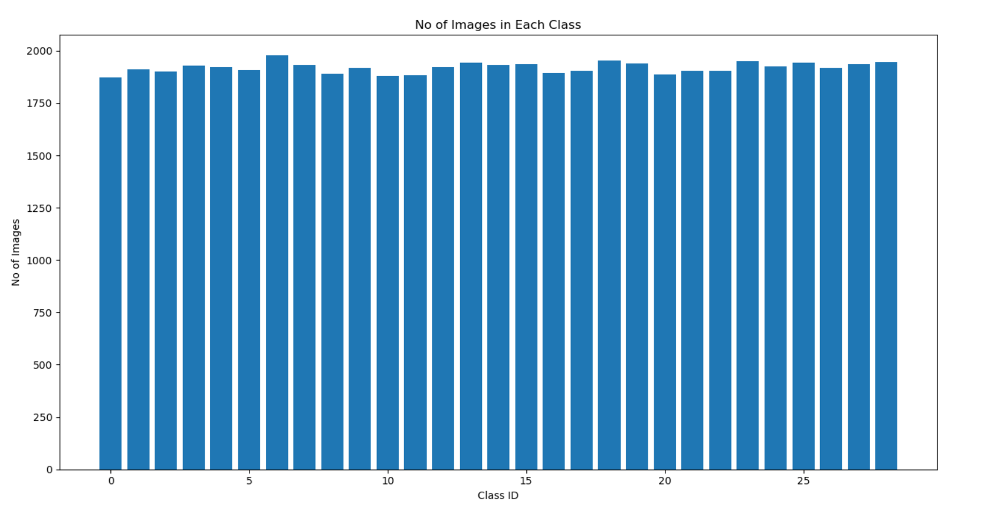
DATA SET USED
The data set used in the project was downloaded from Kaggle which contains about 87,000 images and approximately 1600 images per Alphabet.

Slide 18
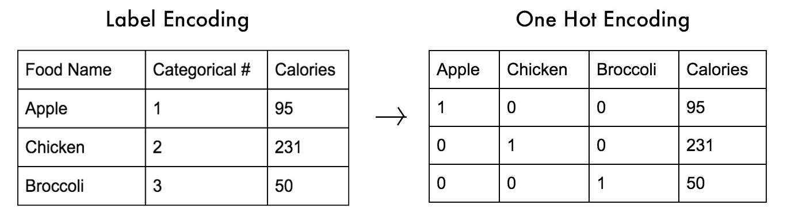
SPLITTING OF DATA
The images used in the project are split in a ratio of 80 : 20 for both Training and Validation Set
The Training set is one – hot encoded to convert categorical values to numeric in order to make the dataset more nuanced and generic.

Slide 19

MODEL USED
A Convolutional Neural Network (ConvNet/CNN) is a Deep Learning algorithm which can take in an input image, assign importance (learnable weights and biases) to various aspects/objects in the image and be able to differentiate one from the other. The pre-processing required in a ConvNet is much lower as compared to other classification algorithms. While in primitive methods filters are hand-engineered, with enough training, ConvNets have the ability to learn these filters/characteristics.
A CNN sequence to classify handwritten digits

Slide 20
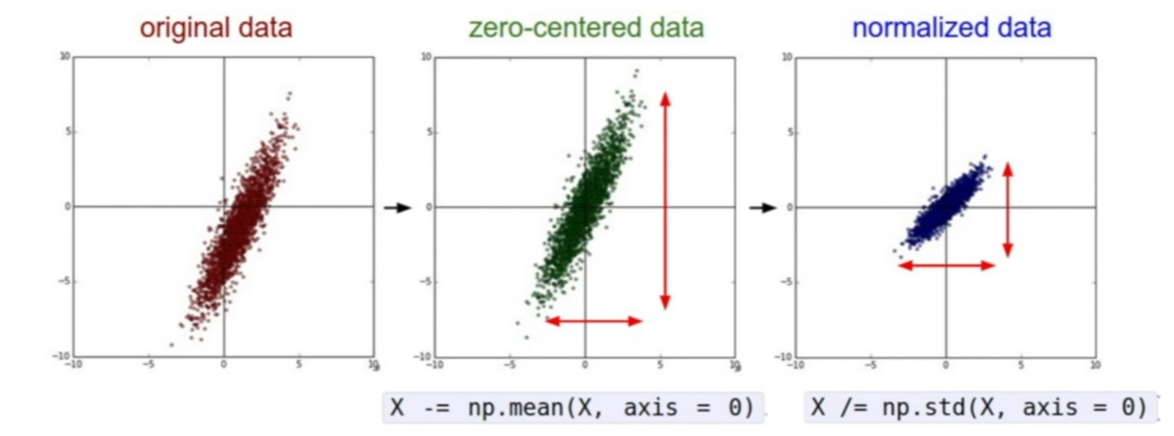
WORKING OF THE MODEL
The Model follows a sequential architecture i.e. it is built layer – by - layer using the Sequential API.
First, the model is fed a Gray – Scale Image which is pre – processed by using the cvtColor() function provided by OpenCV.
During the pre – processing stage, the image is zero –centered.

Slide 21
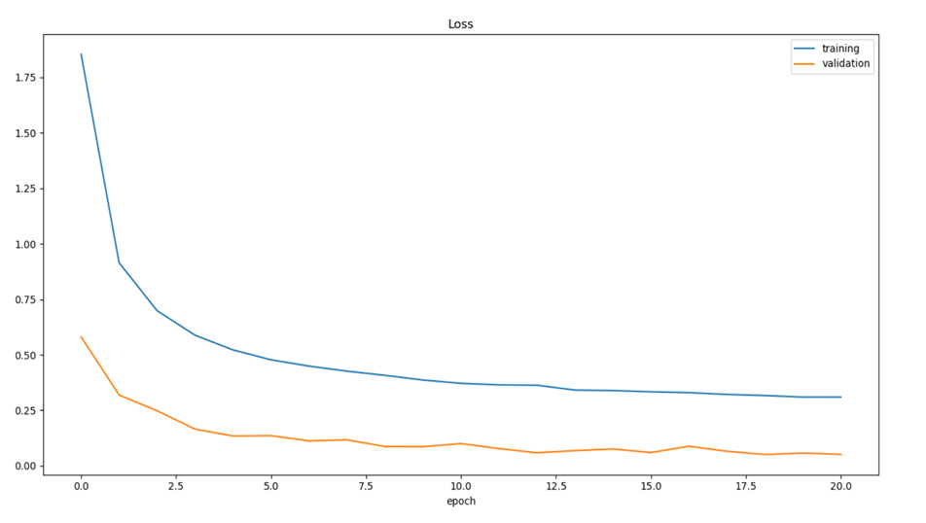
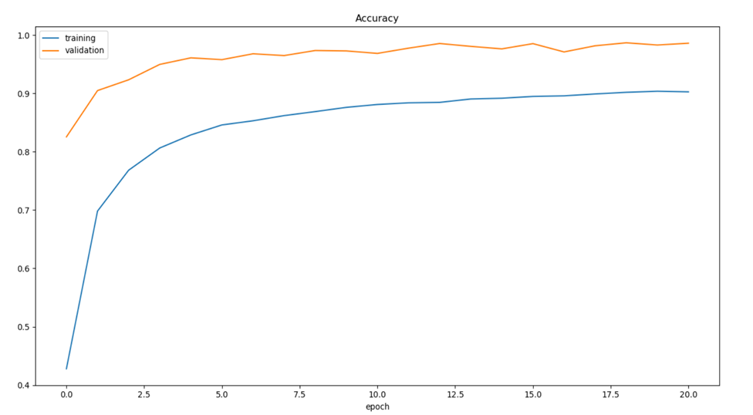
LOSS AND ACCURACY
The model ran 21 Epochs with a batch - size of 50 sample images

Slide 22

MOTIVATION BEHIND THE IDEA
WHY ?

Slide 23
4 MAJOR FACTORS
Covid-19 Pandemic
Non – Existence of “Normalcy”
Noise Pollution
High Decibels of Sound affecting the people
QSR Market Share
Large Market Capitalization
CAGR
Serendipitous Growth Rate

Slide 24
THE COVID AFTERMATH
Social Distancing is a concept that has become an integral part of our lives hence the notion of an average citizen to socialize has altered.
The increasing paranoia about the safety of dining outdoors.
Starbucks opened its first drive-thru in India, in a Chandigarh suburb in July. Calling it a 'milestone', Starbucks India CEO said, “The opening of our first drive-thru showcases our commitment to evolving our brand and business.” For the multinational coffee chain that had seen its India revenue (the India venture is a collab with the Tatas) nosedive after lockdown, the new model it is trying out is equally a realization of how reality has changed post-Covid as much as reiterating its continued interest in the Indian market.
While the drive-thru at a plaza off the Chandigarh-Ambala highway is its first in the country, it is the 187th outlet overall.

Slide 25
THE NOISY DILEMMA
Around 466 million people worldwide have disabling hearing loss , and 34 million of these are children.
It is estimated that by 2050 over 900 million people will have disabling hearing loss.
60% of childhood hearing loss is due to preventable causes.
1.1 billion young people (aged between 12–35 years) are at risk of hearing loss due to exposure to noise in recreational settings.
Unaddressed hearing loss poses an annual global cost of US$ 750 billion. Interventions to prevent, identify and address hearing loss are cost-effective and can bring great benefit to individuals.
SOURCE : WHO

Slide 26
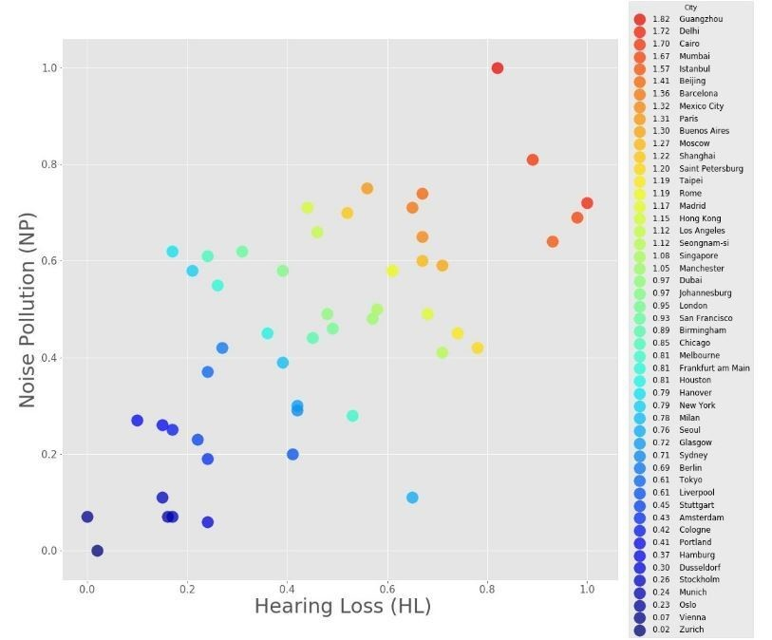
Source : WHO

Slide 27
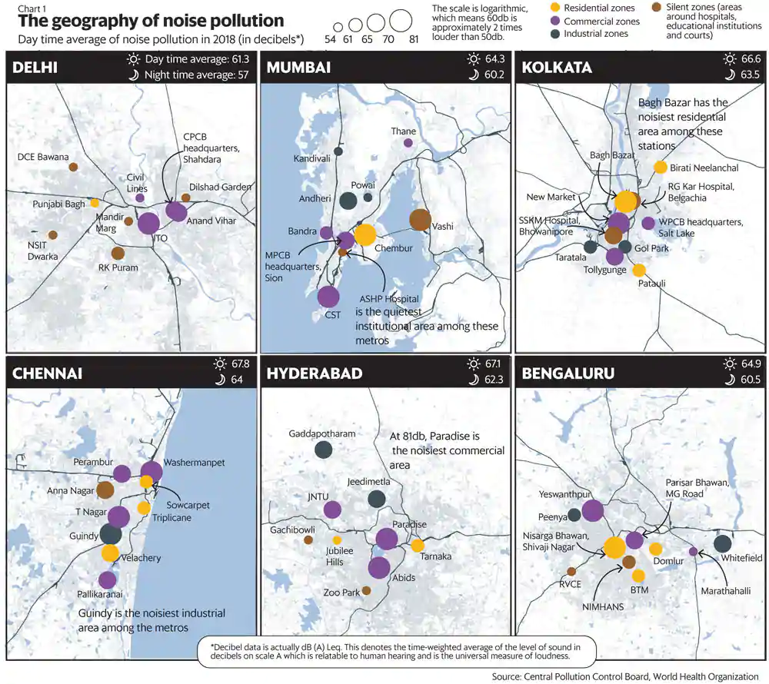
Noise Level Regulations
3 Zones
Residential Zones (55db)
Commercial Zones (65db)
Industrial Zones (75db)

Slide 28
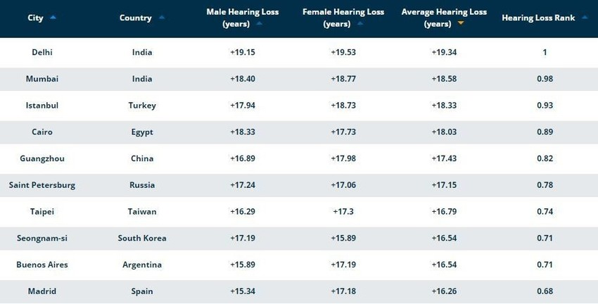
Citizens of Delhi, India have the most, with a hearing age of 20 years older.
Source : Statista

Slide 29
THE PROMISING GROWTH
Fast food market in India is expected to be worth US$ 27.57 billion by 2020.
Fast food Casual dining restaurants (CDRs) market in organized fast food sector in India is projected to grow at a CAGR of 27% by 2019-20.
Quick Service Restaurants (QSRs) market in organized fast food sector in India is projected to grow at a CAGR of 20% by 2019-20.
About 10% of the fast food market in India is organized. NOVONOUS estimates that the organized fast food market in India is expected to grow at a CAGR of 27% by 2020.

Slide 30
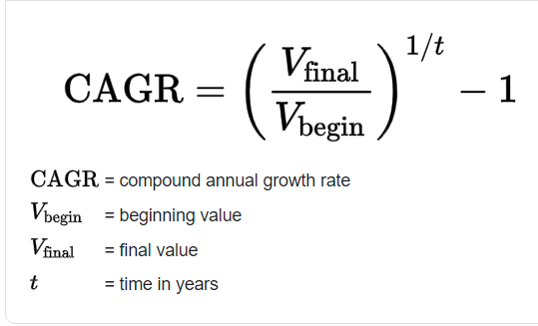
CAGR (Compound Annual Growth Rate)
Quick Service Restaurants Market in India is Projected to Grow at a CAGR Of Over 18% During the Period, 2021-2025

Slide 31
FEASIBLITY AND COST COMPARISON
Average Drive – Through Salary Structure
Crew Member : $13.39 per hour (40 Salaries)
Crew Leader : $14.32 per hour (6 Salaries)
Assistant Manager : $15.49 per hour (5 Salaries)
Maximum Shifts Allowed : 3
Minimum Work shift Hours : 20 hours per Week
Total Amount Spent per Week : $13,979.4
Total Amount Spent per Week (PPP) : $4193.82
Amount in Indian Rupees (PPP) : ₹ 306,830.36 per Week
Cost of the Proposed Drive – Through
Webcam : ₹ 12,115.00
Basic Software Development : $30 per hour($4,800 Total)
Digital Signage: ₹ 4,700 per Board
Total Amount : ₹ 368,035 (One Time Investment)

Slide 32
REVIEW
Our Idea inculcates a sense of awareness amongst the people about Sign Language and Noise Pollution.
It decreases the risk of infection by reducing human contact at a Drive – Through.
Ensures a calm and quick ordering experience at a QSR.
It is feasible and cost efficient than a typical Drive – Through.

Slide 33
WE ARE JUST GIVING YOU A CHOICE
“You cannot control the behavior of others, but you can always choose how you respond to it.”

Slide 34
WE USED THE TOOL CREATED TO COUNTER BARRIERS IN COMMUNICATION AMONGST DEAF AND MUTE PEOPLE TO MAKE LIFE EASIER FOR THEM AS WELL AS FOR PEOPLE IN GENERAL AND ADDRESSED THE DILEMMA OF INCREASING POPULATION WITH A HEARING LOSS

Slide 35
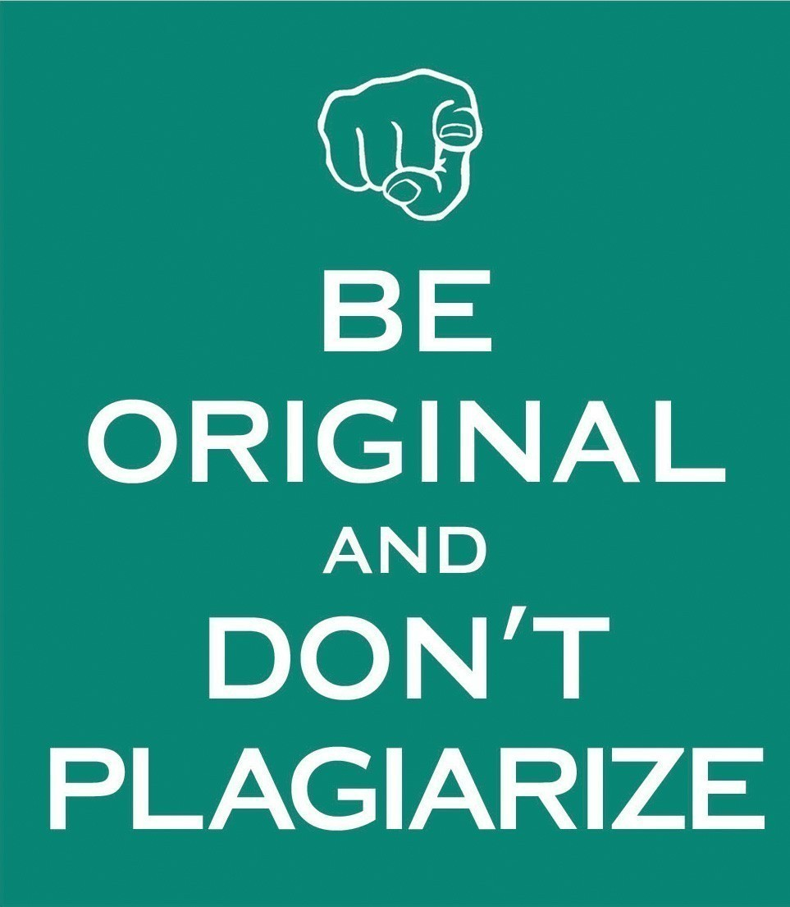
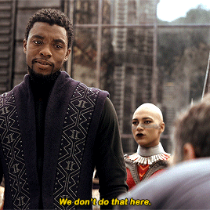
BONUS SLIDE

Slide 36
REFERENCES
A Comprehensive Guide to Convolutional Neural Networks — the ELI5 way by : Sumit Shah.
Text Detection using Neural Networks | OPENCV Python by Murtaza Hassan.
Wikipedia and Stack Overflow
P.S : There is nothing wrong with taking reference from someone else’s code but the blatant incompetence of not mentioning the original author is in clear violation of a coder’s creative integrity.
Be Responsible and Appreciative.

Slide 37
THANK YOU

